Slide 1
Surface Hub
Contoso Jobs Tutorial 0
Explore the Existing App

Slide 2
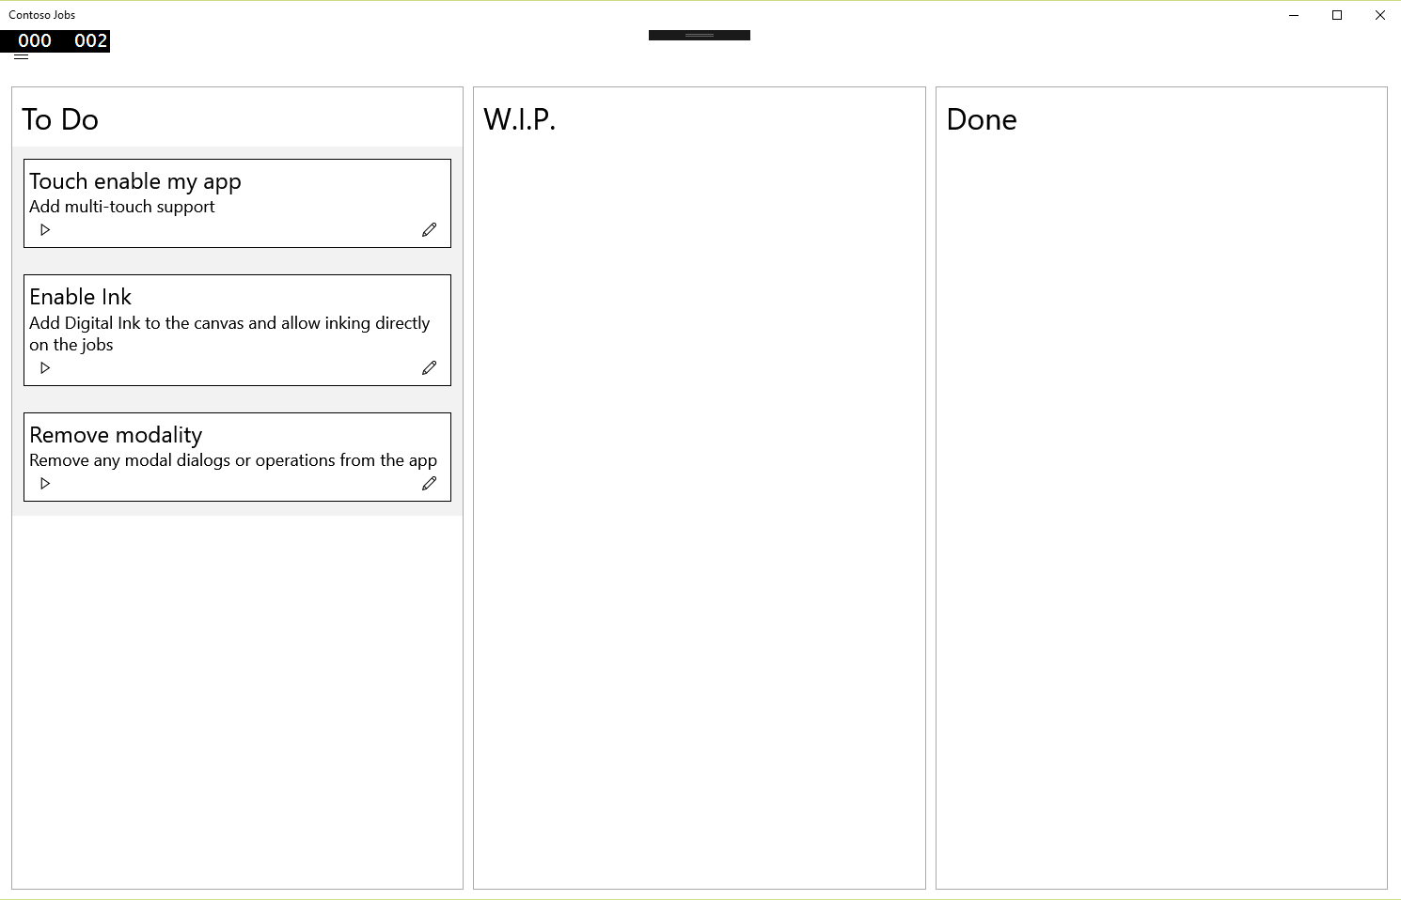
Contoso Jobs
A simple job management board, showing:
jobs to do
work in progress
completed jobs
Notes:
Don’t put a menu right at the top

Slide 3
Contoso Jobs on Surface Hub
Create and edit jobs
Start and finish job

Slide 4
Issues with Contoso Jobs on Surface Hub
Modal dialogs to create and edit jobs
Hamburger menu top left
Small icons for buttons
Indirect manipulation
Keyboard entry only

Slide 5
Contoso Jobs code review
Models; Job, JobStatus
ViewModel; JobsViewModel
Views; Jobs, JobControl, Create/EditJobContentDialog
XmlService, save and load jobs as xml file

Slide 6
Tutorials
Review existing app ✓
Drag and drop
add direct manipulation of the objects on the screen
Inking
add support for multiple pens inking on the screen at the same time
Modality
remove modal dialogs and control
Camera
add support for camera capture
OneDrive store the data in the cloud
NFC
add support to read NFC tags
Notes:
Sharing across the wire – share contract –
One Drive – support

